Slide 1
Managing a Successful Computing Project including user experience features in Community Portal
Module Project
Module: Managing a Successful Computing Project
Course: : Managing a Successful Computing Project for including user experience features in an Existing Community Portal (Project Management Plan)
Start Date :10/10/2022
End Date :26/10/2022
Submission Date :27/10/2022
Learner Name : Chathushi Jayarathna
Enrollment ID :
Presentation Date :

Slide 2
Contents
Document History
Version Number | Effective Date of release | Summary of Included Changes | Author
1 | 4th March 2016 | First Edition | Satya CVS
2 | 16th Oct 2017 | Changed for Module 6 | Shrinivas K R

Slide 3
Contents
Contents
S. No. | Description
01 | Different Types of Testing
02 | How Different Testing Helps
03 | Tests Selected
04 | Test Schedule
05 | Test Results
06 | Testing Tools
07 | Project Milestone & Tasks
08 | Milestone Feedback & Action Taken
09 | Modifications Made Based on Feedback
10 | Project Results
11 | Proposed Improvements

Slide 4
1. Different Types of Testing
List types of Testing
Unit testing
UAT testing
Integration testing
Beta testing
Black box testing
White box testing
Usability testing
Load testing
Security testing

Slide 5
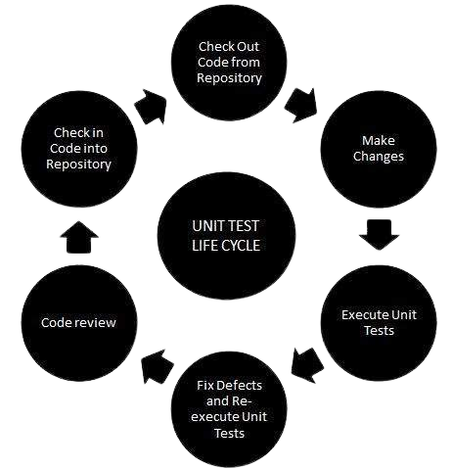
1. Different Types of Testing
Functional Testing
Unit Testing
Unit testing is a software development process in which the smallest testable parts of an application, called units, are individually and independently scrutinized for proper operation. This testing methodology is done during the development process by the software developers and sometimes QA staff. The main objective of unit testing is to isolate written code to test and determine if it works as intended.

Slide 6
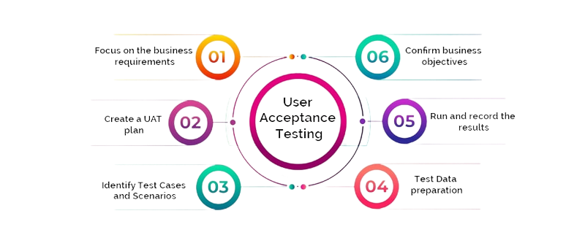
1. Different Types of Testing
User Acceptance Test
UAT (User Acceptance Testing) is a type of testing performed by the end-user or the client to verify the software system before moving the software application to the production environment. UAR is done in the final phase of testing after functional, integration, and system testing is done

Slide 7
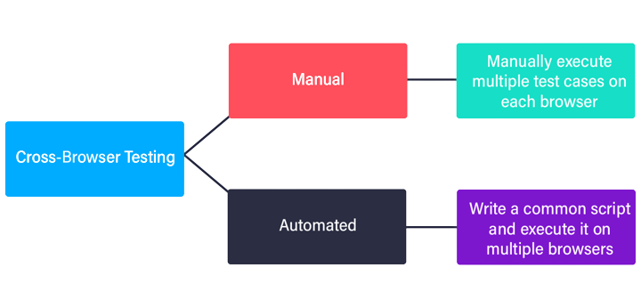
1. Different Types of Testing
Non-Funtional Testing
Cross-browser Testing
cross-browser testing, additionally called browser testing, is a great assurance (QA) system that checks whether a web-based totally application, site, or web page feature is meant to stop users across multiple browsers and devices.
Reduction of repetitive work
Greater consistency and repeatability
Ease of access to information about tests or testing

Slide 8
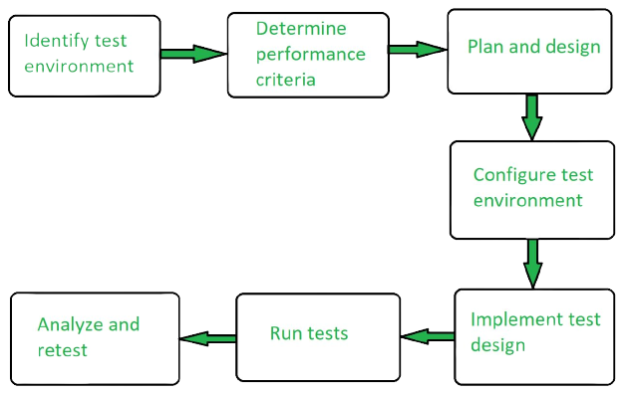
1. Different Types of Testing
Performance Testing
Overall performance testing is a form of software testing that guarantees software packages perform well underneath their anticipated workload. it's miles a trying out technique completed to determine device overall performance in phrases of sensitivity, reactivity, and balance under a particular workload.
performance testing is the procedure of studying the fine and capability of a product. it's far a checking out method carried out to determine the system performance in phrases of pace, reliability, and stability under varying workloads. overall performance trying out is also called Perf testing.

Slide 9
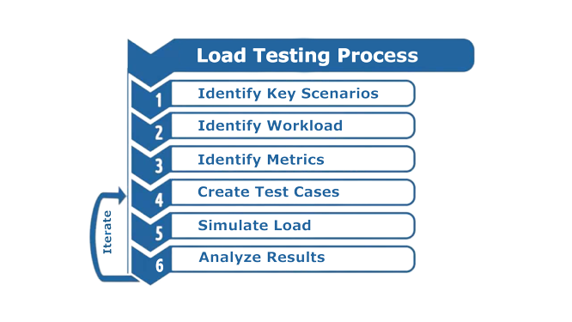
1. Different Types of Testing
Load Testing
Load testing is a sort of performance testing that determines the overall performance of a device, software product, or software utility below actual life primarily based on load conditions. basically, load testing determines the behavior of the utility while multiple users use it at the identical time. It is the reaction of the system measured under various load conditions. The burden testing is finished for regular and severe load conditions

Slide 10
2. How Different Test Helps
Functional Testing
Unit Testing 1. Helps developer write better code 2. It helps developer to catch bugs earlier 3. It makes the code more easy to refactor
User Acceptance Testing 1. Keeping ongoing maintenance costs as low as possible 2. Increase end-user happiness 3. Increasing software robustness and usability
Integration Testing 1. Integration testing for different modules at the same time is easy. 2. It can be used in the early as well as later stages of the testing process. 3. It improves test coverage and provides an additional level of reliability.

Slide 11
2. How Different Test Helps
Non-Functional Testing
Cross Browser Testing 1. Reduction of repetitive work 2. Greater consistency and repeatability 3. Ease of access to information about tests or testing
Performance Testing 1. Measure the speed, accuracy and stability of software 2. Performance testing allows you to keep your users happy 3. Improve optimization and load capability
Load Testing 1. Minimizes the cost of failure for organizations. 2. Improves software scalability. 3. Reduces the risk for system downtime.

Slide 12
3. Tests Selected
List the testing methods selected to test the project
Functional Testing
1. Unit Testing
2. User Acceptance Testing (UAT)
Non-Functional Testing
1. Cross Browser Testing

Slide 13
4. Test Schedule
Scheduling:
No | Web page | Weighting | Functional Points (FP) | Total
1 | Registration | 3 | 5 | 15
2 | Login | 2 | 3 | 6
3 | Logout | 1 | 3 | 3
4 | Forgot Password | 3 | 3 | 9
5 | Search Users | 2 | 4 | 8
6 | Update user profile | 2 | 2 | 4
7 | View user profile | 1 | 5 | 5
8 | Posting Jobs | 2 | 2 | 4
9 | View User Response | 2 | 5 | 10
10 | Send bulk email | 3 | 2 | 6
11 | Apply Job | 3 | 3 | 9
 | Total functional points |  |  | 79
 | Estimated person hour/ FP |  |  | 2
 | Total hours needed |  |  | 158
 | Total days needed (8h/day) |  |  | 19

Slide 14
4. Test Schedule
Test Schedule:
Test Schedule ID : | TS001
Product ID / Name : | ABC Community Portal
Product Version or Build: | 1.0
Present Owner : | ABC PVT LTD
Created On : | 25/09/2022
Review On : | 12/10/2022
Review By : | Chathu | QA Manager
Review Comments : | Good
Current Version : | 1.0
Change Details : | Not Available
Current Status : | Approved
Signing Off Authority : | Kevin, Leo, Kara | Software Developer, QA Manager, Client | 10/07/2022

Slide 15
5. Test Results
Unit Testing (Registration)
9 | Test Case | Preconditions | Test Step | Test Data | Expected Results | Actual Results | Pass / Fail
TC001 | Test Case 1 | The user should have the URL of the website and open the homepage of the abcjobs.com | Type URL Click “Sign up” on the website home page linked to the registration page. Enter all the fields. Click submit. Run Junit4 | Name = Chathu Email = chathu@gmail.com Phone = 0742269976 City = Colombo Password = 12345 Repeat Password = 12345 | Not register | As expected, | Pass
TC002 | Test case 2 | The user should have the URL of the website and open a homepage of the abcjobs.com | Type URL Click “Sign up” on the website home page linked to the registration page. Enter all details except the name Click submit. | Name = chathu Email =chathushi0707@gmail.com Phone = 0742269976 City = Colombo Password = 12345 Repeat Password = 12345 | Email will sent to the registered email account | As expected, | pass
TC003 | Test case 3 | The user should have the URL of the website and open a homepage of the abcjobs.com | Type URL Click “Sign up” on the website home page linked to the registration page. Enter all the fields Enter all details except the email address Click submit. | Full Name: Chathushi Jayarathna Email Address: chathushi0707@gmail.com Phone Number:0742269976 Select Gender: Female Password: 1234 Repeat Password:1234 | Data will be saved in the database | As expected, | pass

Slide 16
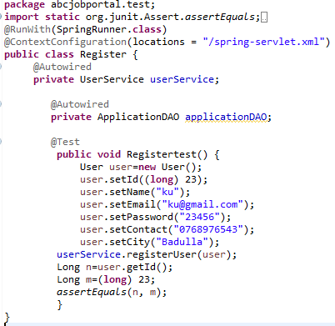
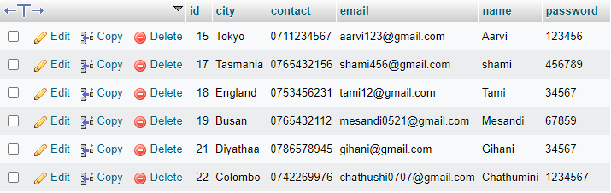
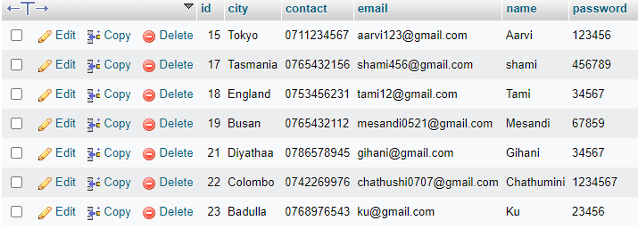
5. Test Results
Unit Testing
Database Before
Database After

Slide 17
5. Test Results
Unit Testing (Login)
Test Case ID | Test Case | Preconditions | Test Step | Test Data | Expected Results | Actual Results | Pass / Fail
TC001 | Test Case 1 | The user should have the URL of the website and open a homepage of the abcjobs.com | Type URL Fill up the form of login with already registered an account. Click submit. Run Junit4 | Email = chathushi0707@gmail.com Password = 1234567 | Loaded welcome t hank you page | As expected, | Pass
TC002 | Test case 2 | The user should have the URL of the website and open a homepage of the abcjobs.com | Type URL Click “Sign up” on the website home page linked to the registration page. Fill up the form with wrong password Click submit. | Email = chathushi0707@gmail.com Password = 12345 | Welcome thank you page not loaded | As expected, | pass

Slide 18
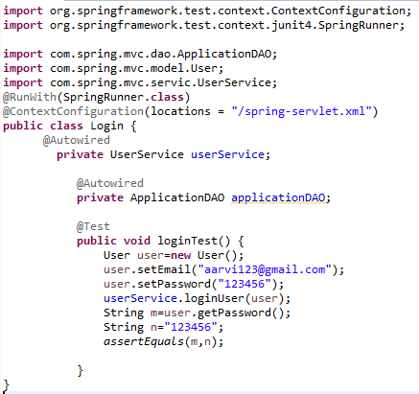
5. Test Results
Unit Testing

Slide 19
5. Test Results
User Acceptance Testing
Test Scenario | Landing Page
TS003
Test Cases | UAT Testing
UAT01 | Check each hyperlink menu is loading correct page
Scenario ID | Test Case ID | Test Case | Preconditions | Test Step | Test Data | Expected Results | Actual Results | Pass / Fail | Evidence
TS003 | UAT01 | Check hyperlink menu is loading the correct page | The user should have the URL of the website and open a homepage of the abcjobportal.com | Go to Microsoft Edge Type www.abcjobportal.com and enter Click on all the links provided for test | Click on the register link | Loaded Register page | As expected, | Pass | UAT 01(1) UAT 01(2)
 |  |  |  |  | Click on the login link | Loaded Login Page | As expected, | Pass | UAT 01(1) UAT 01(3)

Slide 20
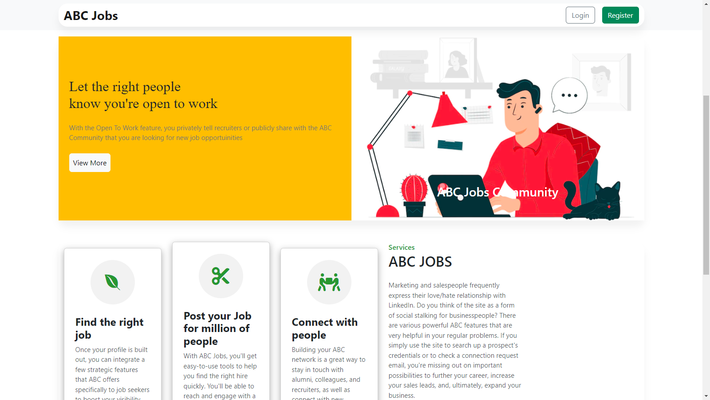
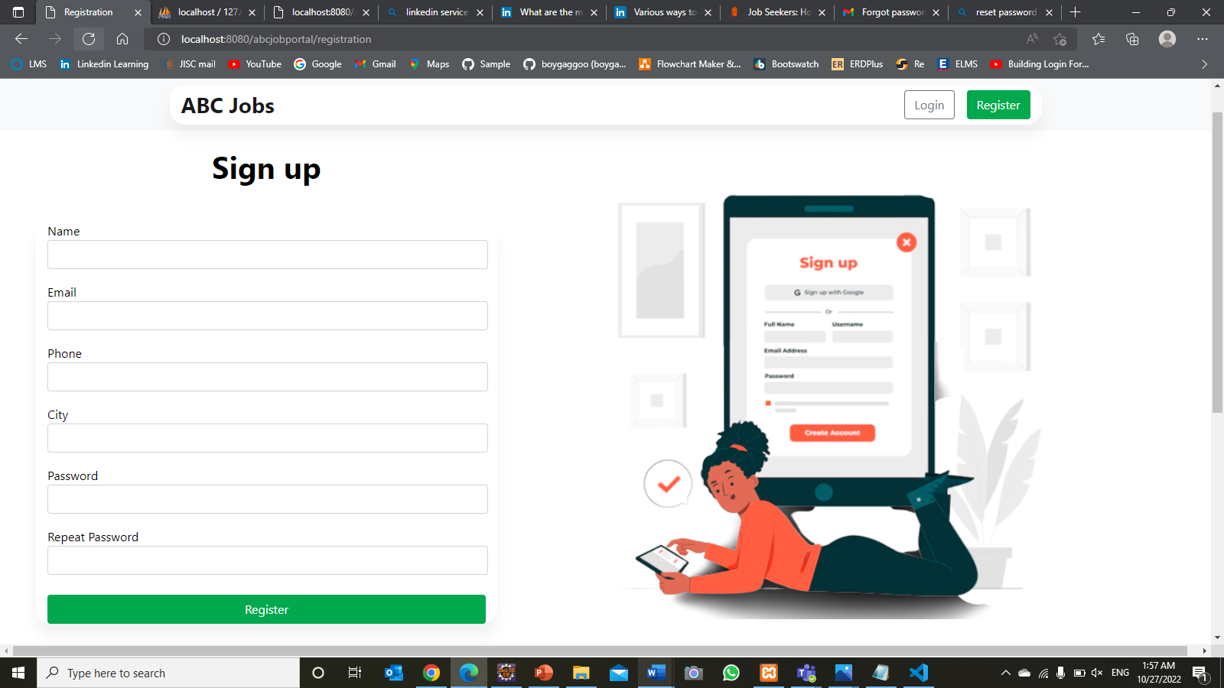
5. Test Results
TS003 - UAT01(1)

Slide 21
5. Test Results
Cross Browser Testing
Test Scenario | Check that the application is run normally on multiple web browser
TS003
Test Cases | Cross Browser Testing
CBT01 | Check browser can run on Google Chrome web browser using lamdatest
Scenario ID | Test Case ID | Test Case | Preconditions | Test Step | Test Data | Expected Results | Actual Results | Pass / Fail | Evidence
TS003 | CBT01 | Check browser can run on Google Chrome web browser using lamdatest | The user should have the URL of the website and open a homepage of the abcjobportal.com | Go to Microsoft Edge Type www.abcjobportal.com and enter Click on all the links provided for test | ABC Jobs Portal website hosted in ngrok software | Run normally as it should | As expected, | Pass | CBT 01(1)

Slide 22
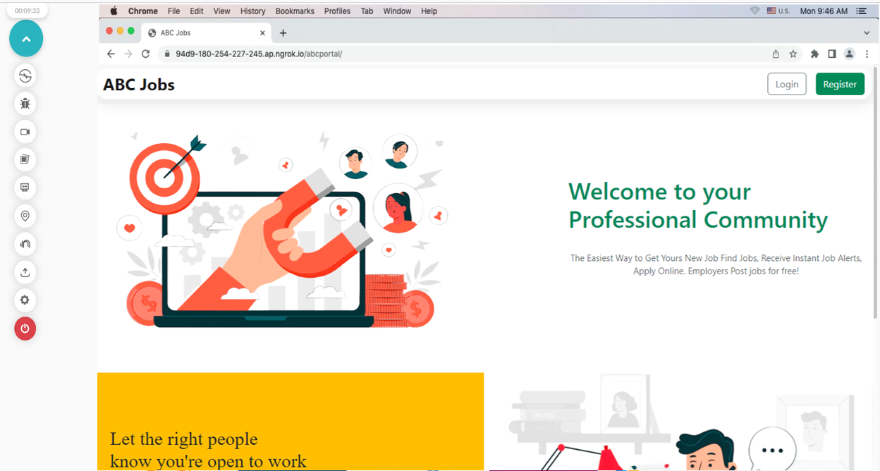
5. Test Results
Cross Browser Testing

Slide 23
7. Project Milestones & Tasks
Project Task ID | Project Task Description | Project Milestone ID
1 | Analyze and suggest choice of Test Methods | 1
2 | Schedule the Test Optimally | 1
3 | Develop the Phase Test Plan | 1
5 | Develop Test Cases & Scripts | 2
6 | Execute the Tests & Document the results | 3

Slide 24
8. Milestone Feedback & Action taken
Project Milestone ID | Milestone Feedback received from Tutor / Learning Facilitator | Action Taken (Yes / No)
1 | Adding scheduling calculation in project presentation | Yes
2 | Test the DAO layer directly | Yes

Slide 25
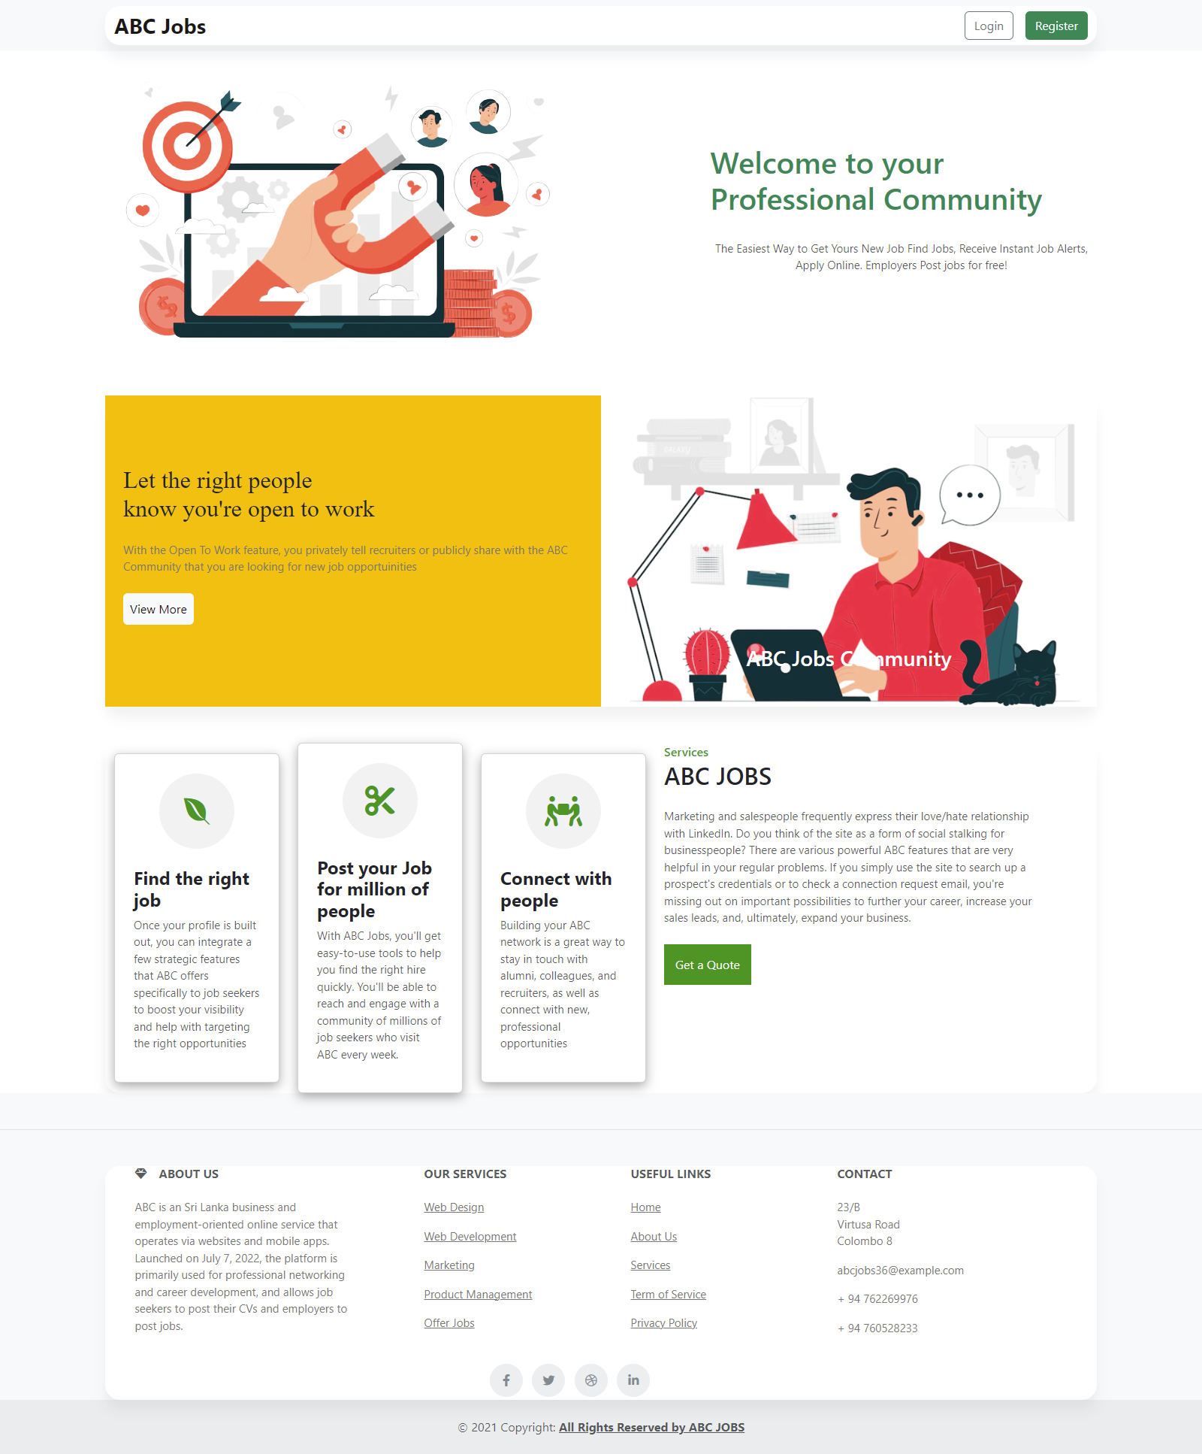
10. Project Results
Index Page

Slide 26
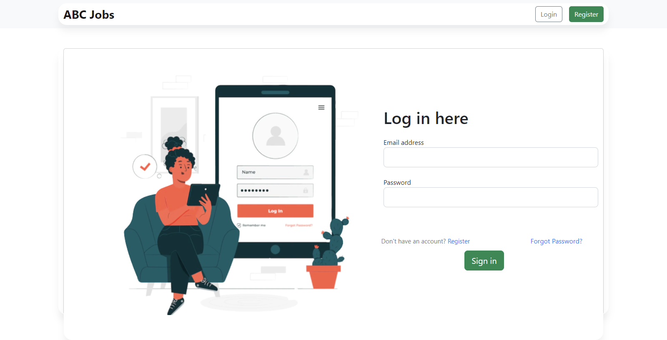
10. Project Results
Login

Slide 27
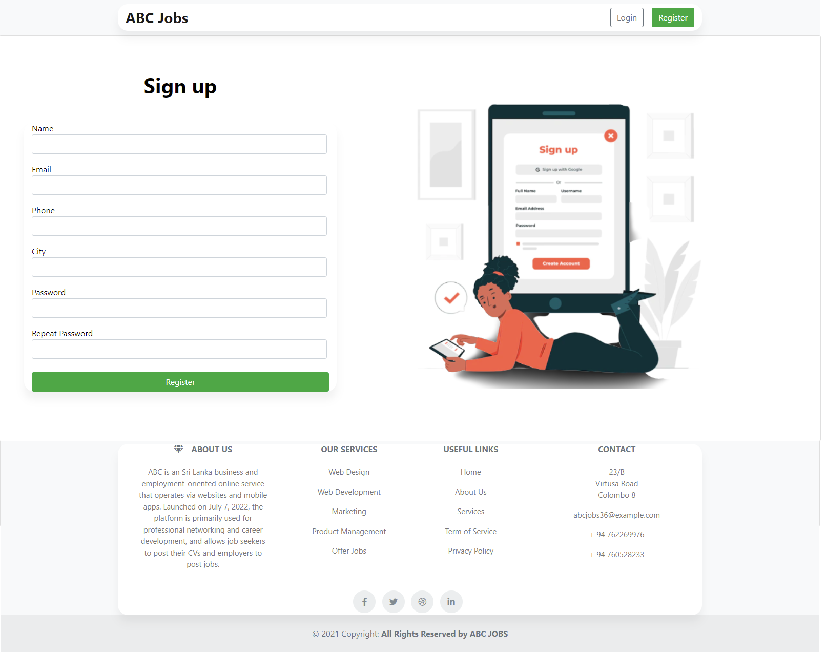
10. Project Results
Registration

Slide 28
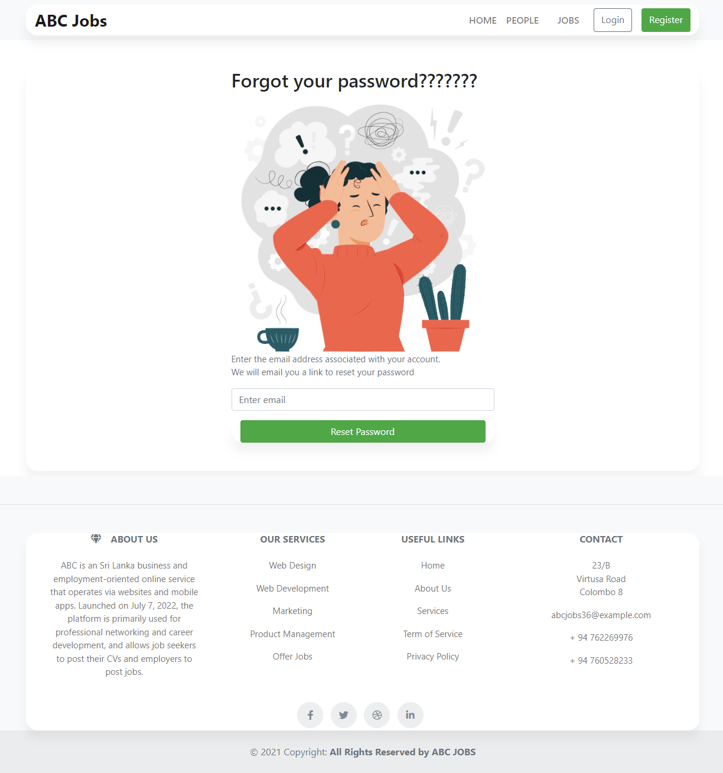
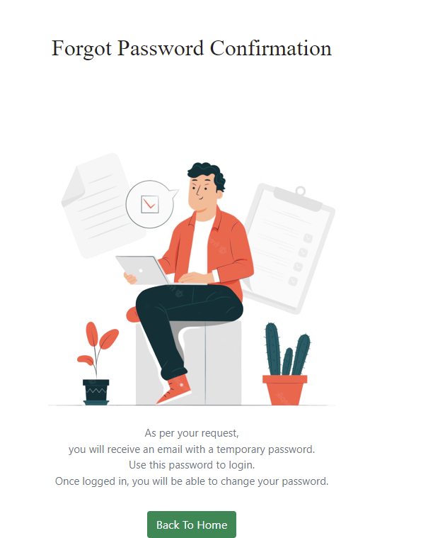
10. Project Results
Forgot Password
Forgot Password Confirmation

Slide 29
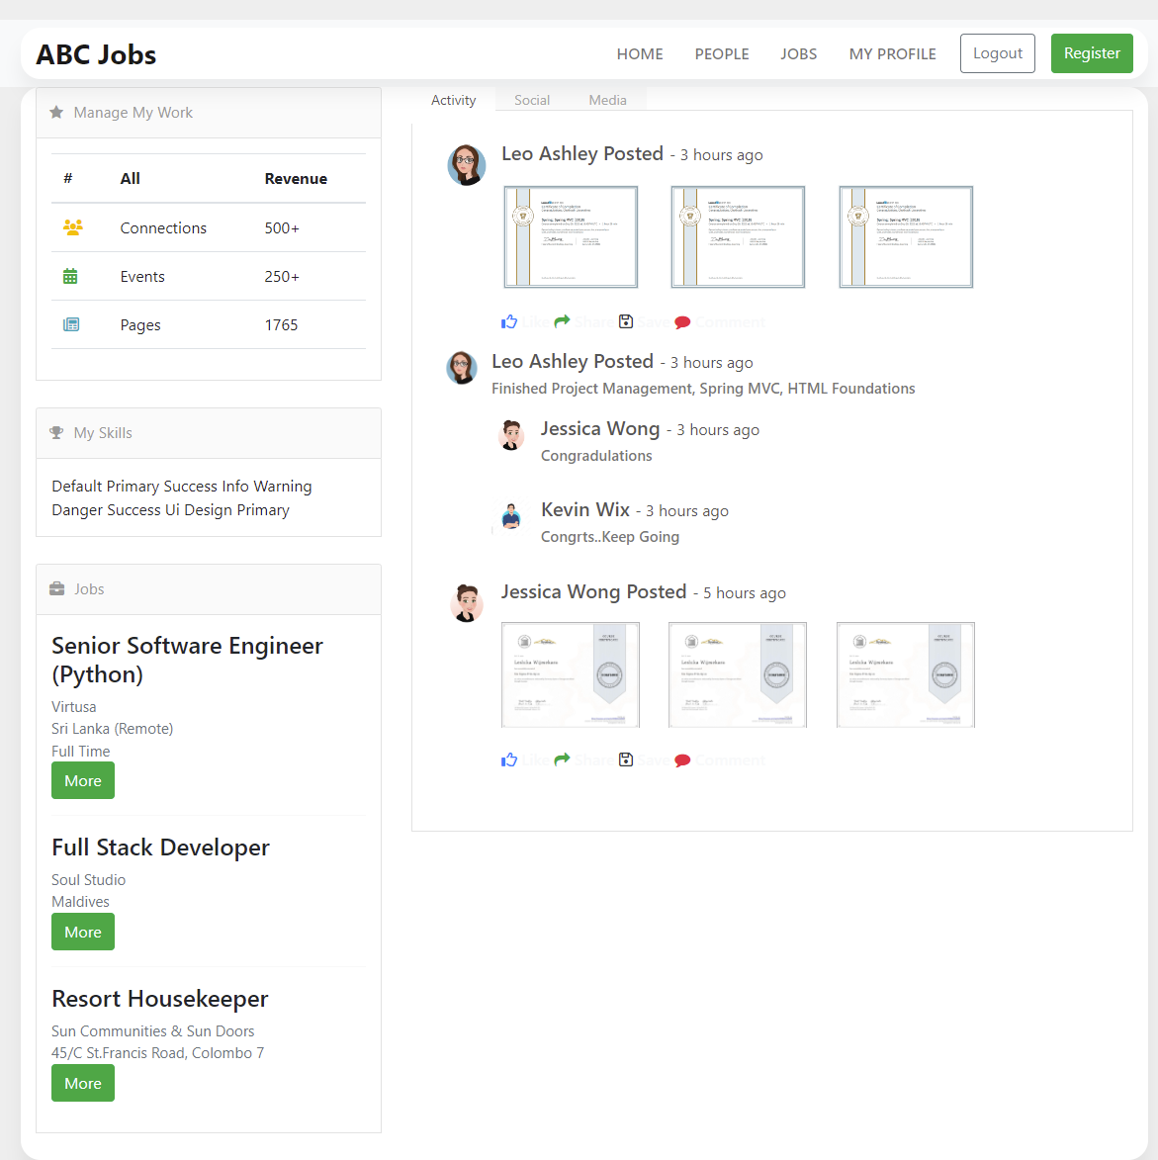
10. Project Results
User Home Page

Slide 30
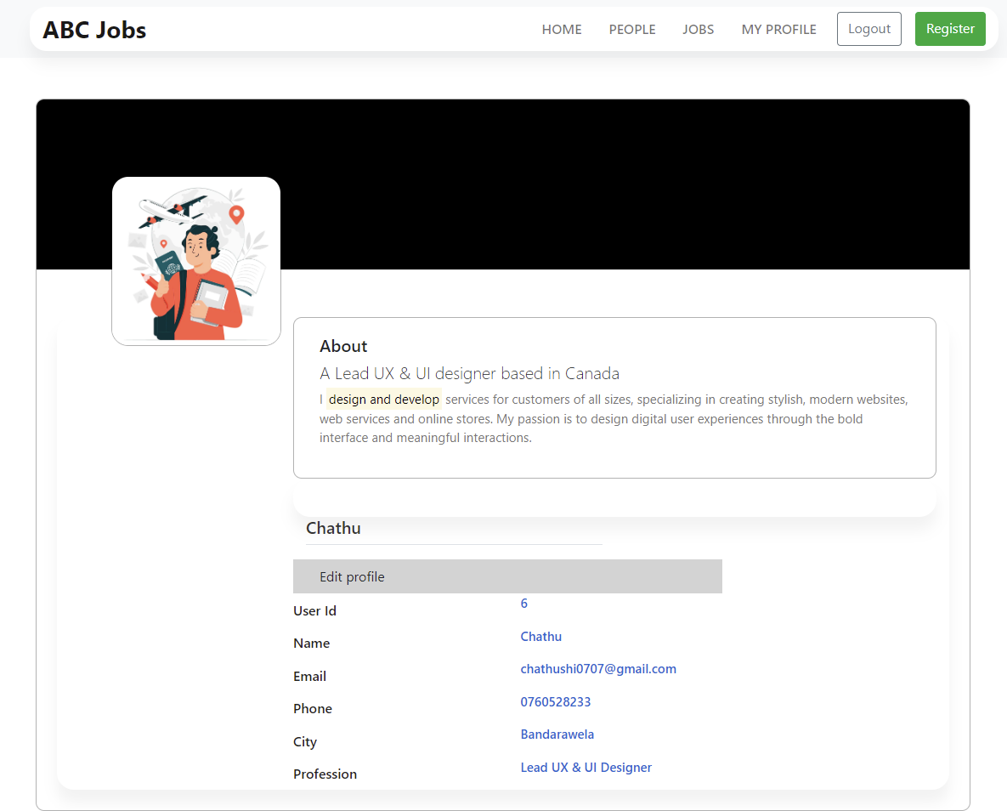
10. Project Results
User Profile Page

Slide 31
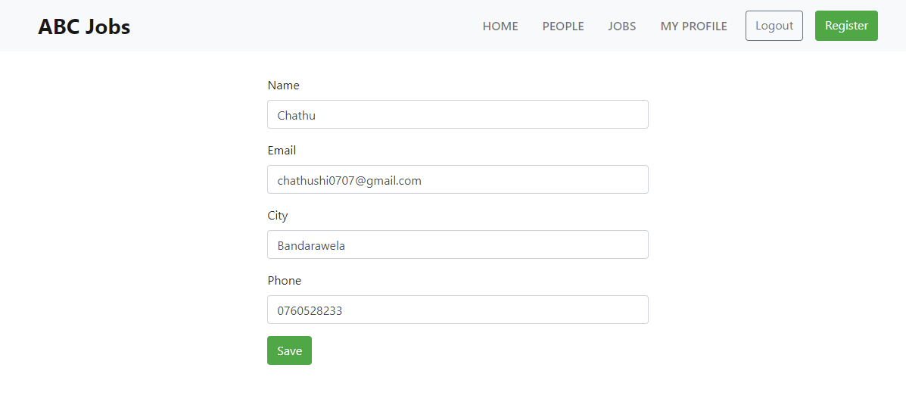
10. Project Results
User Edit Profile

Slide 32
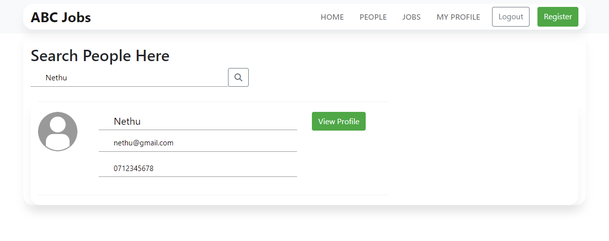
10. Project Results
Search User Page

Slide 33
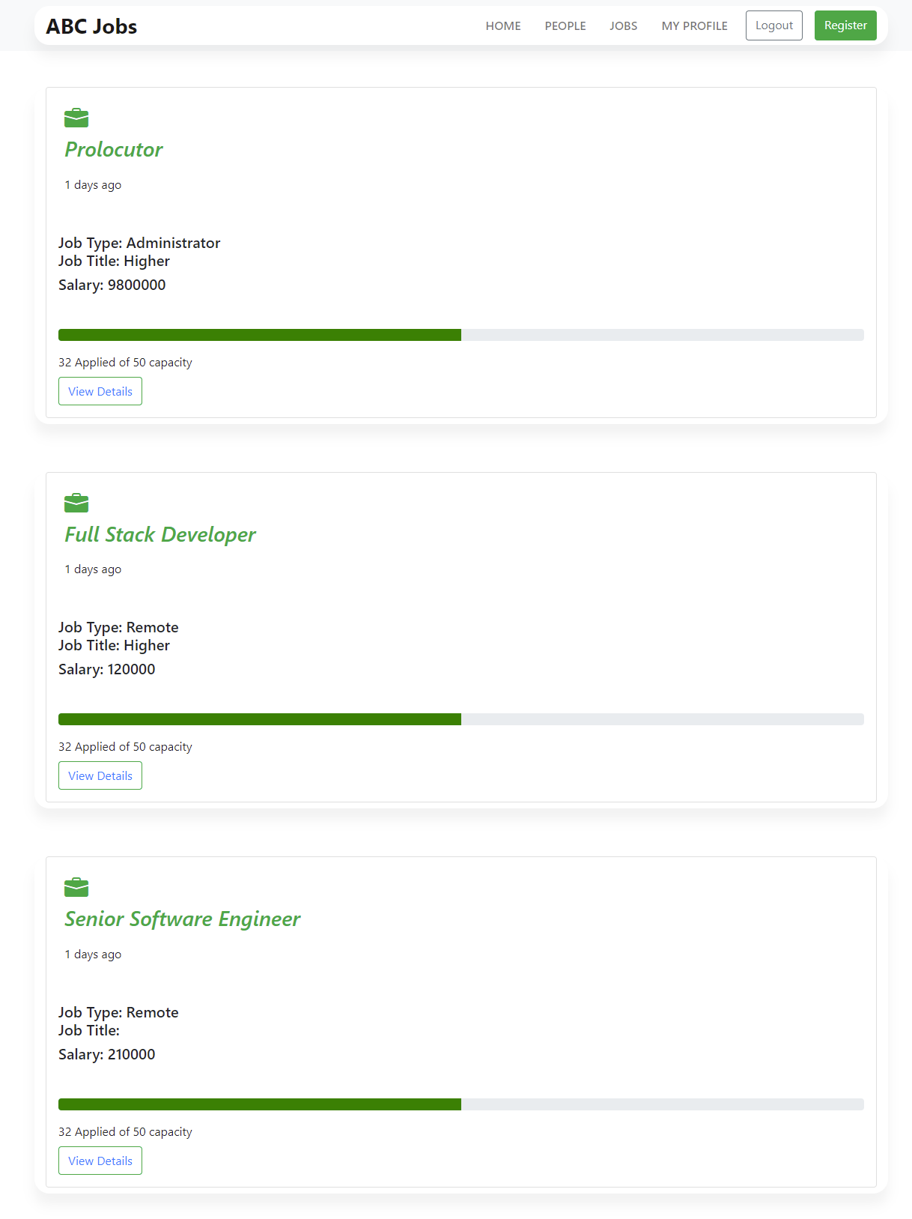
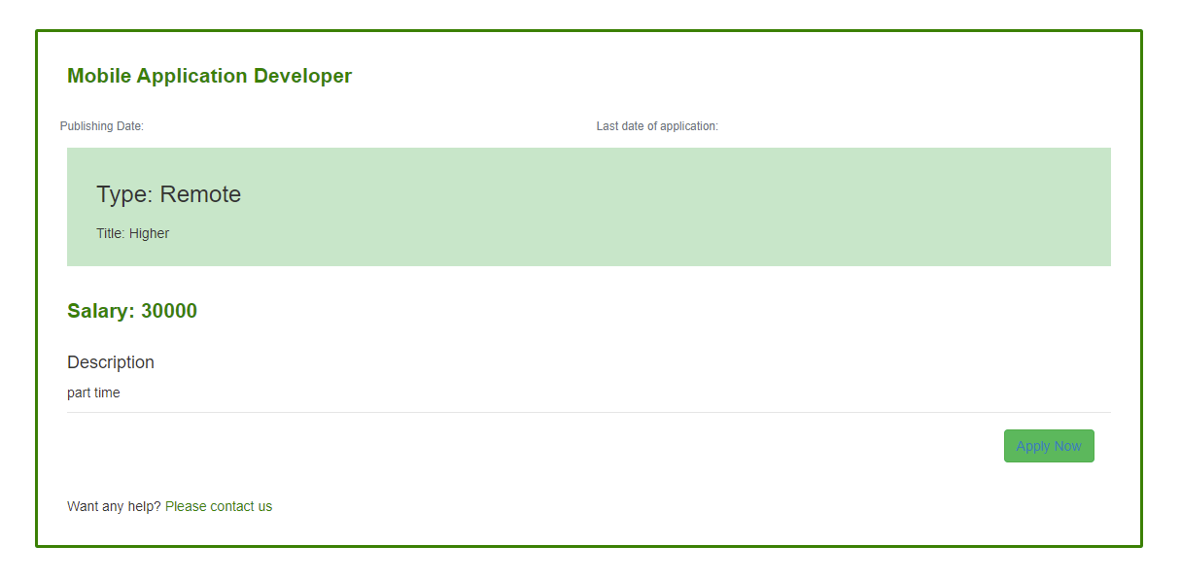
10. Project Results
User – View Job

Slide 34
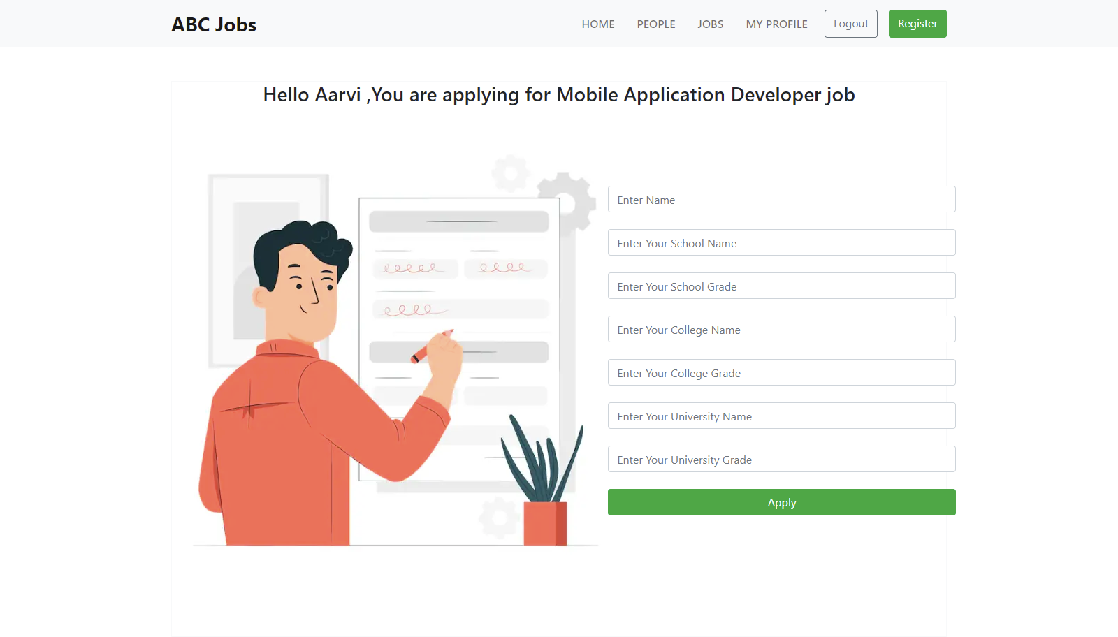
10. Project Results
Apply Job

Slide 35
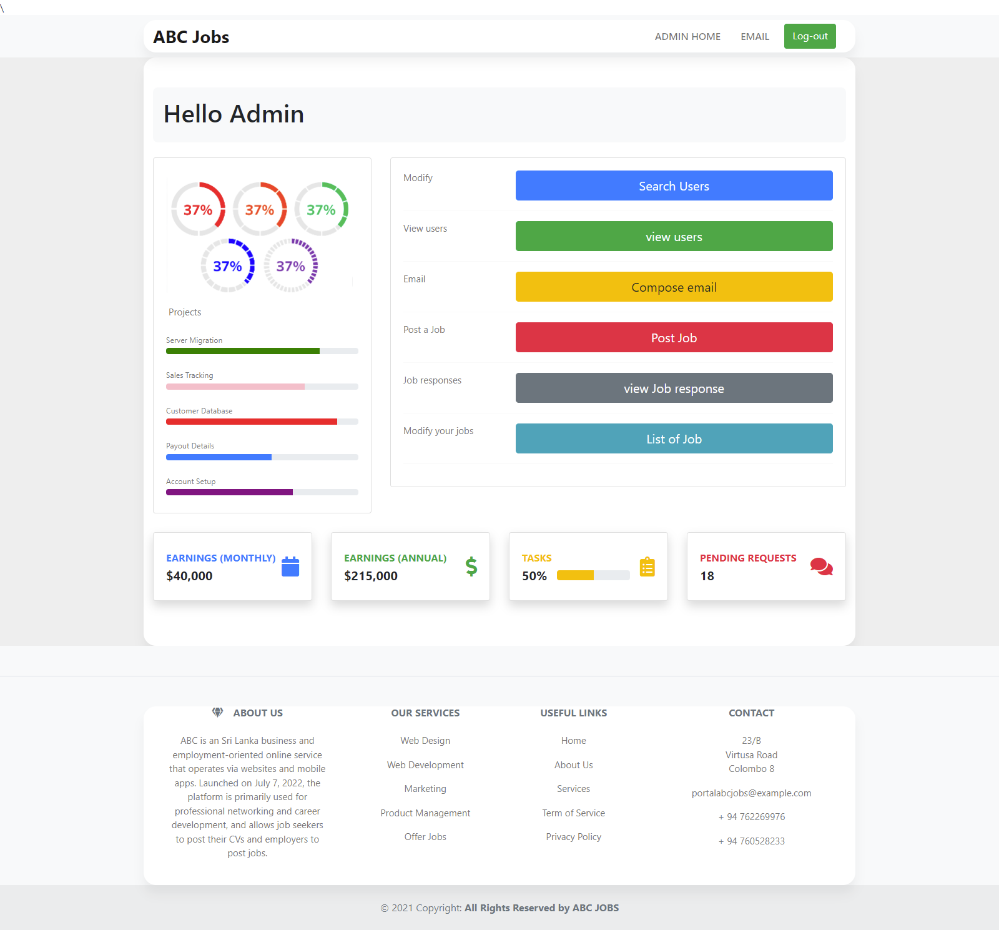
10. Project Results
Admin Profile Page

Slide 36
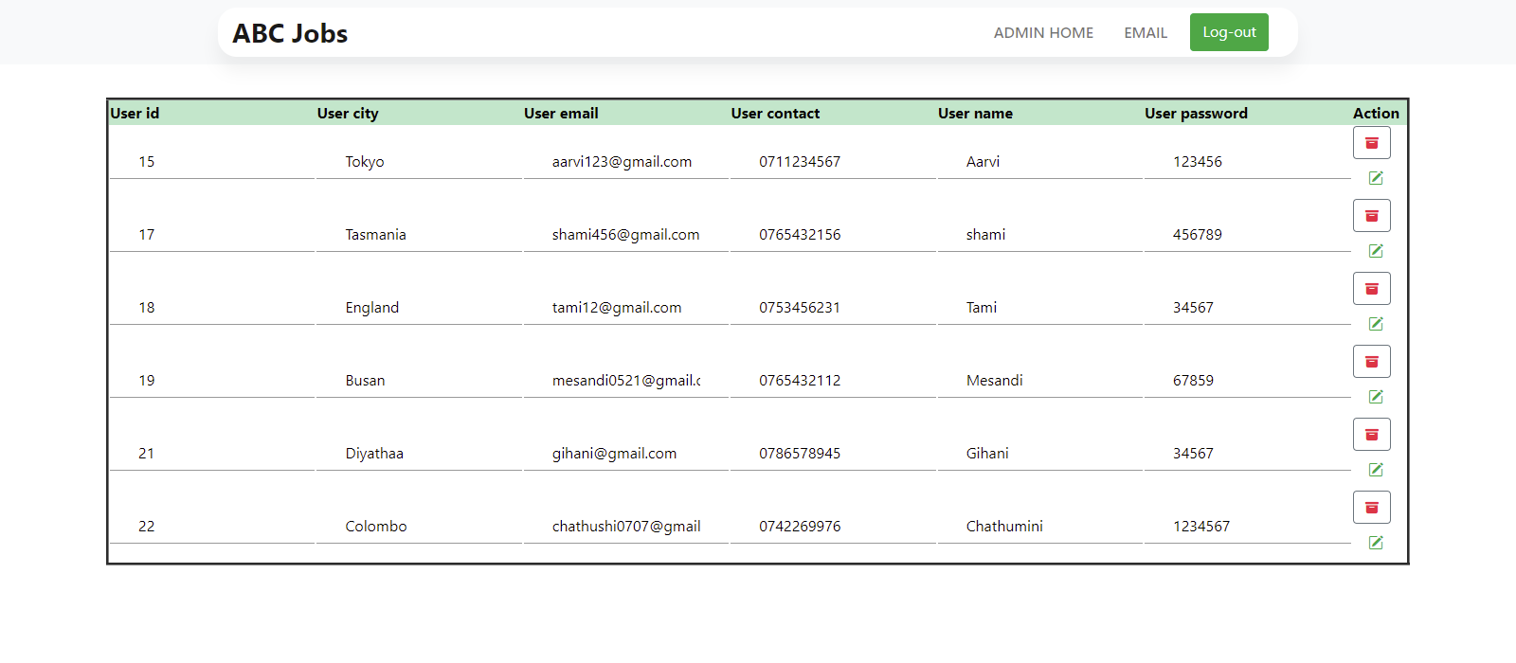
10. Project Results
Admin View User Page

Slide 37
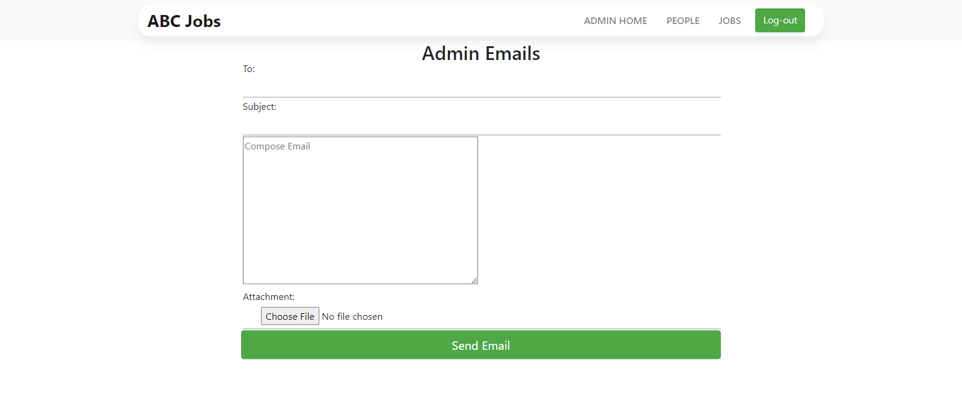
10. Project Results
Bulk Email

Slide 38
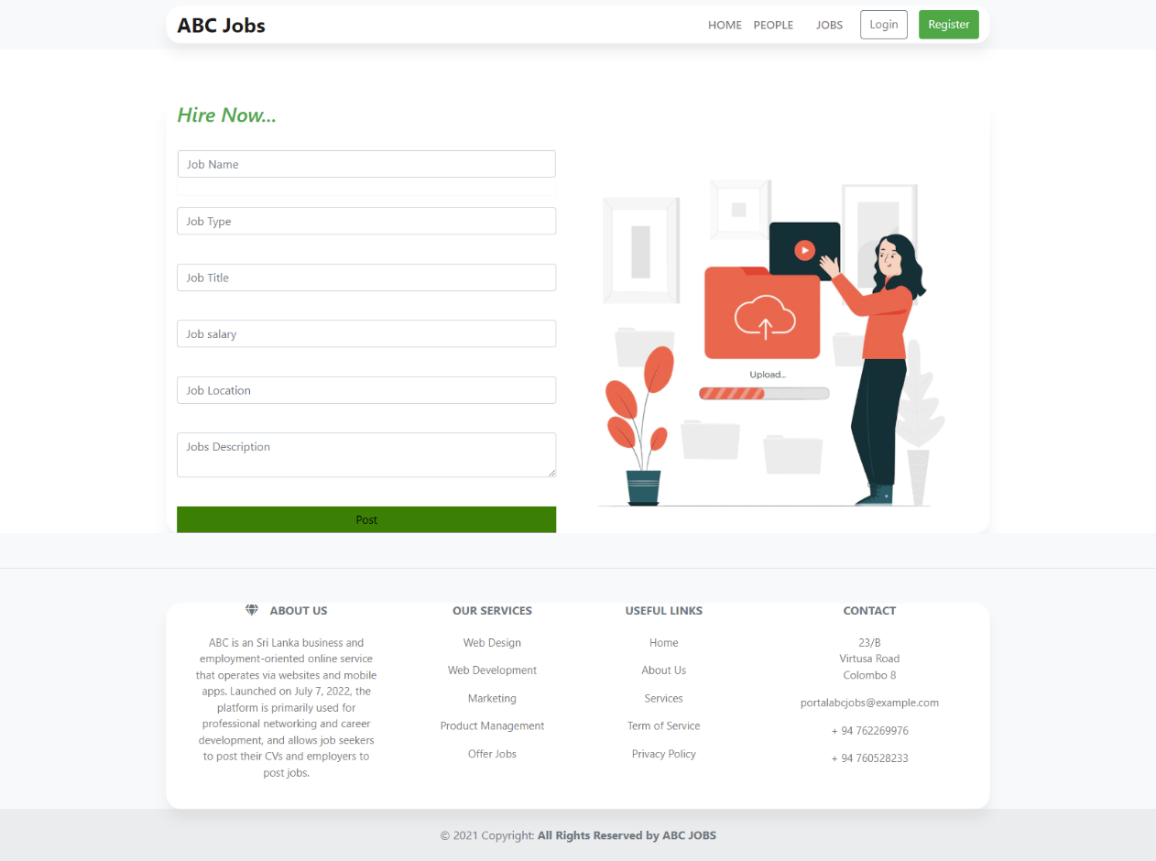
10. Project Results
Post Job

Slide 39
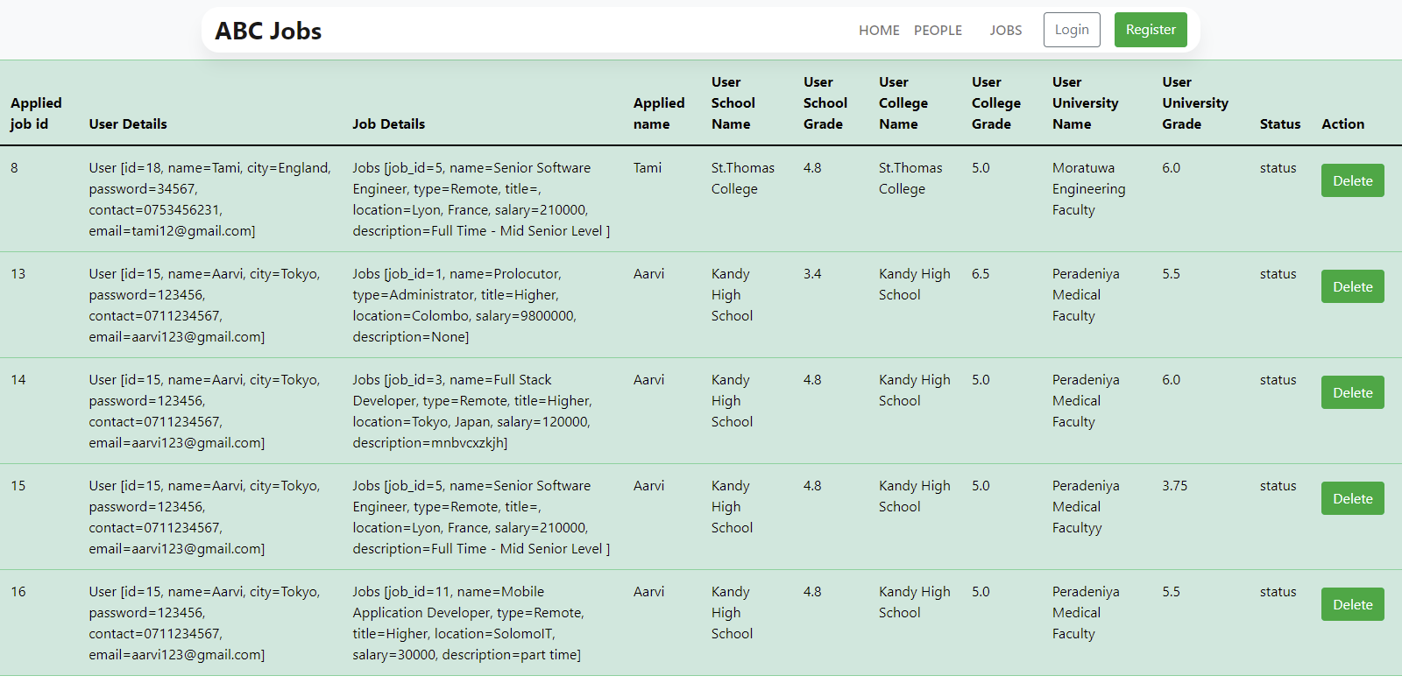
10. Project Results
View Job Response

Slide 40
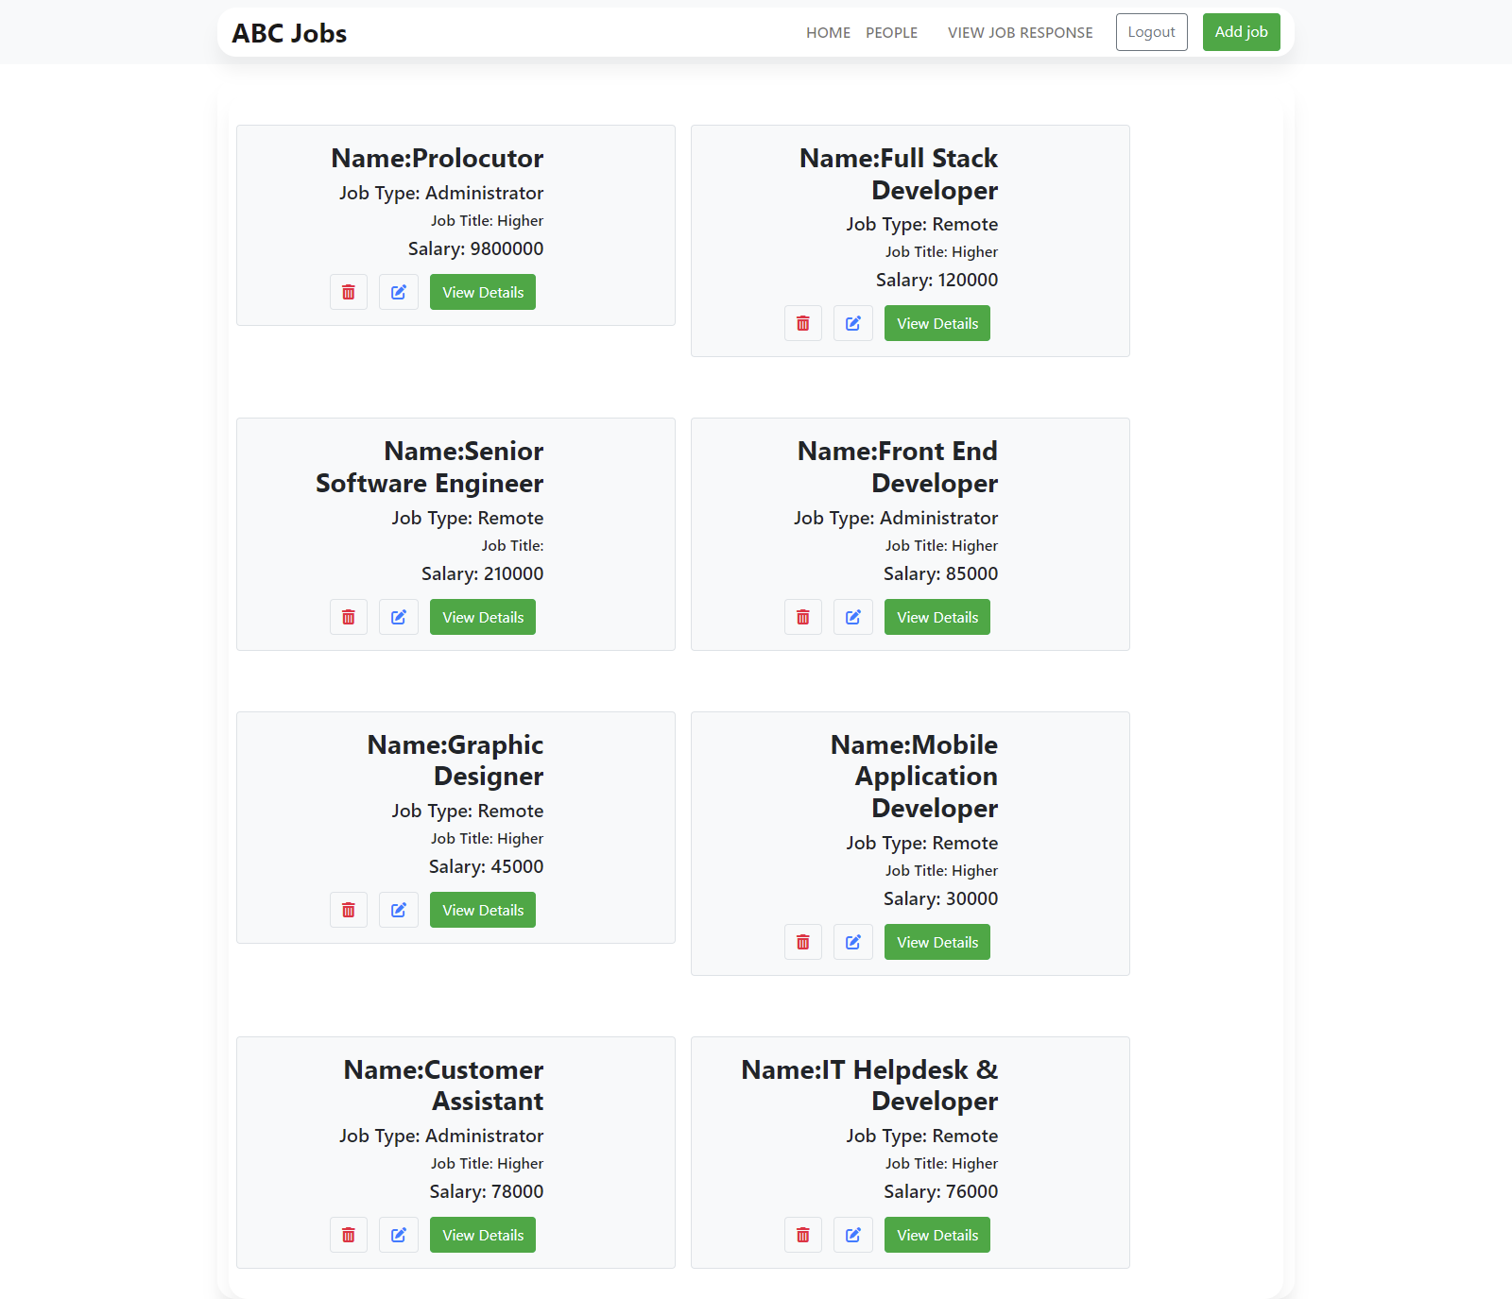
10. Project Results
List Jobs

Slide 41
11. Proposed Improvements
List of Improvements
Making better test script
Learn more about testing software application

